Slide 1

PRESENTED BY : Baireddy Manisha(17UK1A0506) Mamindla Shalini (17UK1A0526) Madishetti Manisha (17UK1A0535) Padakanti Ramya (17UK1A0509)
MINI PROJECT PRESENTATION
VAAGDEVI ENGINEERING COLLEGE
TEAM-9
PROJECT NAME:-LUNG CANCER DETECTION IN RADIOLOGY IMAGES Using CNN
PROJECT GUIDE:
Dr. Srikanth Jannu
professor

Slide 2
TABLE OF CONTENTS:
ABSTRACT
EXISTING SYSTEM
PROPOSED SYSTEM
IMPLEMENTATION
ARCHITECTURE DESIGN
SOFTWARE DESIGNING
IMAGES OF RESULT
ADVANTAGES AND DISADVANTAGES
CONCLUSION
FUTURE SCOPE

Slide 3
ABSTRACT
Lung cancer is a dangerous disease that taking human life rapidly worldwide.
The death of the people is increasing exponentially because of lung cancer. In order to reduce the disease and save a human's life, the automated system is needed.
To minimize this problem, many systems have been proposed by using different image processing techniques, machine learning, and deep learning techniques.
Physician and radiologist use the CT scan images to analyze, interpret and diagnose the lung cancer from lung tissues. However, in most cases, obtaining an accurate diagnosis result without using the extra medical tool known as a computer- Aid detection and Diagnosis (CAD)system is tedious work for many physicians.
To obtain an accurate result from computer-aided diagnosis system lung segmentation methods are basic once. So in this project, we have used convolutional neural network and designed a CNN model that has best performance

Slide 4
EXISTING SYSTEM
The previous models have high time complexity and space complexity whereas this model is constrained with the lot of advantages and with a higher accuracy than any other model already proposed.
And it is very difficult to detect it in its early stages as Its symptoms appear only within the advanced stages . Implementing the system to automate the classification process for the first prediction of cartinoma.
.

Slide 5
PROPOSED SYSTEM
Convolutional neural networks (CNN) are all the rage in the deep learning community right now. These CNN models are being used across different applications and domains, and they’re especially prevalent in image and video processing projects.
A convolutional neural network (CNN) is a specific type of artificial neural network that uses perceptrons , a machine learning unit algorithm, for supervised learning, to analyze data.
CNNs apply to image processing, natural language processing and other kinds of cognitive tasks.
A convolutional neural network is also known as a ConvNet.
Like other kinds of artificial neural networks, a convolutional neural network has an input layer, an output layer and various hidden layers. Some of these layers are convolutional, using a mathematical model to pass on results to successive layers. This simulates some of the actions in the human visual cortex.

Slide 6
IMPLEMENTATION
Convolution Neural Network
Input data
Input layer
Hidden layers
Output layers
Output data

Slide 7
ARCHITECTURE DESIGN
Import image dataset
Related module features
Convolution neural network
Result
Performance measure
Classification & prediction

Slide 8
SOFTWARE DESIGNING :
Jupyter Notebook Environment
Spyder Ide
Machine Learning Algorithms
Python(pandas , numpy , matplotlib , seaborn , sklearn)
HTML
Flask

Slide 9
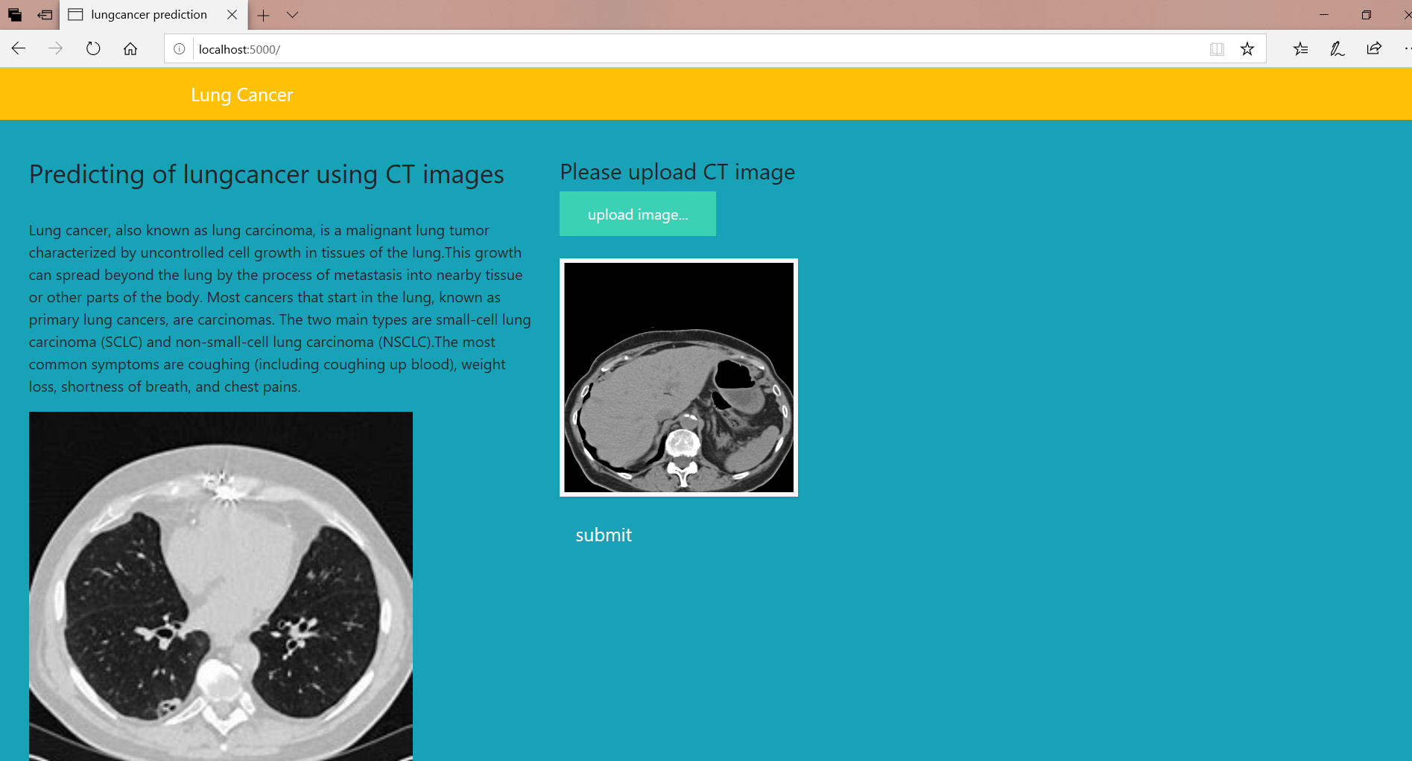
IMAGES OF RESULT
INPUT

Slide 10
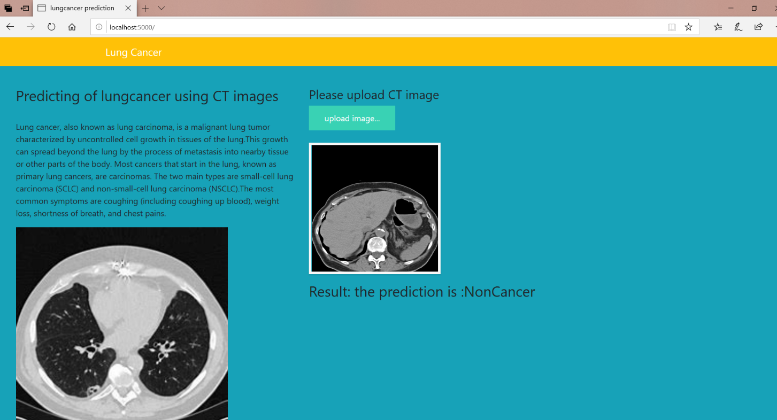
OUTPUT

Slide 11
ADVANTAGES AND DISADVANTAGES
ADVANTAGES:
Highly detailed: Of all the internal imaging procedures available to physicians, the CT scan is the most detailed, and can give a doctor the most complete picture of what’s happening inside a patient’s body. They are particularly useful and widely used in diagnosing cancer an CNN is an added advantage for the physicians to easily predict the lung cancer.
Precise: Because CT scan gives a doctor a very clear picture of where a tumor or other problem is located and whether it has spread, it can help her in planning a biopsy, surgery, radiation or other treatment with more precision. Easily prediction can be done which results in faster treatment for the patient.
4. Once trained, the predictions are pretty fast.
DISADVANTAGES:
Needs a clear image for prediction Not robust to unclear images it may predict but it may be not robust in predicting. But in order to predict perfectly the Classification of Images should be done with different Positions

Slide 12
CONCLUSION
We obtained proof of concept that CNNs can be used as a tool to assist in the staging of patients affected by lung cancer.
In this research, we used CNN classifier to determine whether a CT image of lung is cancerous or non-cancerous. Before using CNN, we preprocessed the CT image through a thresholding technique. We have performed a thorough experiment using LUNA 16 dataset. Our obtained detection accuracy is 80%, which is better than existing methods.

Slide 13
FUTURE SCOPE
The generality of our method also suggests that it can be adapted to other tumour-and/ cancer diagnosis problems.
The design of our project does not rely on any particualr feature of lungs or lung cancer,and so we can easily adapt our pipeline to other nodular cancers,or perhaps other diseases.
In future, we can perform the experiments on a large amount of data and apply more features such as nodule size, texture and position for further improvement. We can also try to apply the state-of-the-art deep CNN methods for higher accuracy and use our method on other types of cancer detection.

Slide 14
THANK YOU

